Slide 1
Cognitive Abilities: Designing for a broad spectrum
Kurt Mattes
Senior Accessibility Engineer
Notes:
Focus is on what any of us can do at a specific moment, not what we cannot do in general

Slide 2
Our Cognitive Abilities
A wonderful, unique set of stimulus processing abilities
That vary…A LOT
Between people
In the same person (mood, over time, episodic event, agentic state)
A factor in determining intelligence, but
Brilliant people have cognitive accessibility needs too
Notes:
Episodic event, migraine
Brilliant people, simple example…Sir Richard Branson

Slide 3
The Conundrum We Made
Notes:
Conundrum simply because human cognitive ability is highly variable

Slide 4
Icon-fest
Notes:
I like icons, they are everywhere – in cars, on appliances, in elevators, in computer applications, on mobile devices and the web
Icons save space and make things more interesting to look at
Generally intended to convey a single task or meaning through a universal language
Icons also represent the good/bad conundrum in the world of cognitive abilities
They convey meaning by association –
Which is good
Single symbol conveys one or more words (less to remember, less language barrier)
Can be easy to recognize, find
And bad
Requires perception, comprehension, recognition, and recall
Can easily be misunderstood

Slide 5
Icon-fest
Women love shopping
Notes:
3 that could be misunderstood

Slide 6
Icon-fest
Notes:
With a mouse, can see it is for an account related menu

Slide 7
Icon-fest
Notes:
Here a tooltip provides helpful information
This symbol is used for another purpose at times – add to favorites

Slide 8
Icon-fest
Notes:
Tooltip here too
Tooltips require ability to use a mouse and reasoning, thinking to put the mouse pointer over something

Slide 9
What do these mean?
or
Notes:
Common icon
Does it mean search or zoom?

Slide 10
“search icon”
“magnify icon”
Notes:
Google says it means both

Slide 11
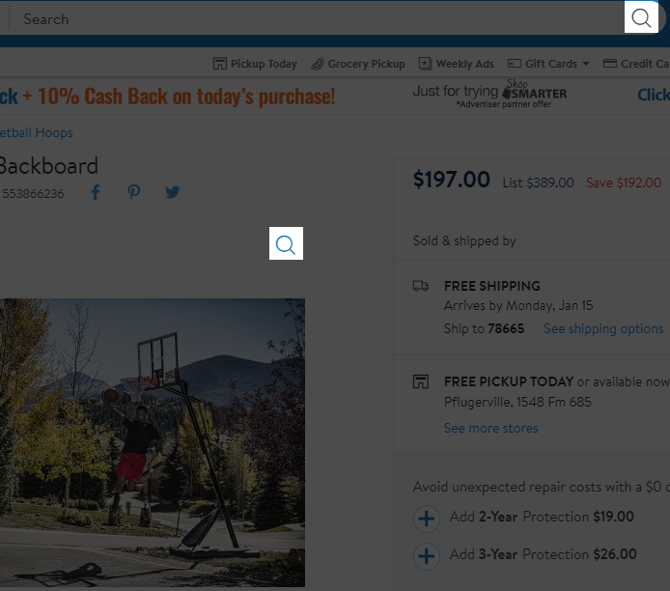
Both meanings – same page!
Notes:
Sometimes both wind up on the same page

Slide 12
A minor variation and…
Research
Magnifiers
for sale
Notes:
Meaning of icons can be very difficult for people to
Comprehend
Remember
Recall

Slide 13
Words too
“Bank”
A place for $
The edge of a river
“Banking”
An activity involving $
The slope of a turn on a racetrack

Slide 14
Context provides meaning
True, but it doesn’t always help
Some people don’t speak icon
Difficulty comprehending, recognizing & remembering meaning
Limited short term memory or attention span
Finding the print icon
Complicated, complex, confusing UI

Slide 15
Notes:
Hard to focus on one thing on this screen – everything wants my visual attention

Slide 16
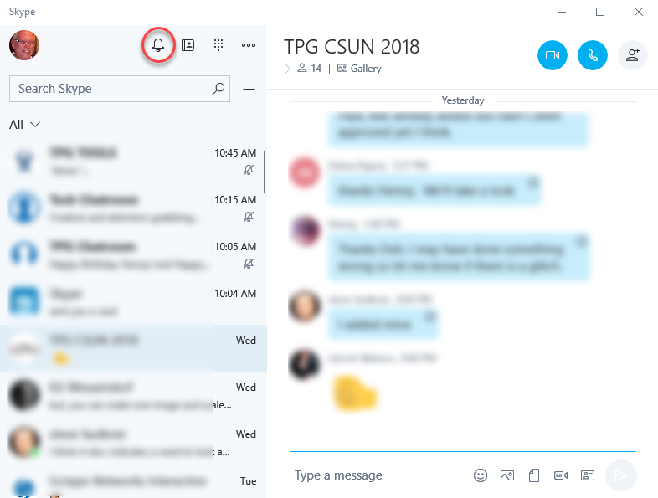
Notes:
What is the purpose of this bell shaped icon?
It’s a bell so it must have something to do with sound, right?

Slide 17
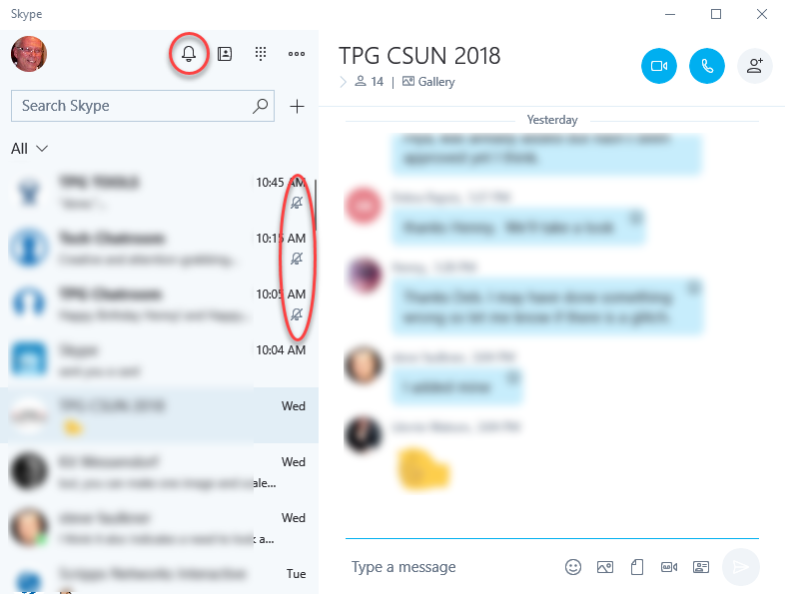
Notes:
And these three slightly smaller version of the icon, but with a line through it that are located next to 3 contacts must mean sounds don’t play when they send a message

Slide 18
Notes:
Fortunately, mouseover the one at the top of the screen and see that it is for notifications
But then does that mean the three contacts don’t get notifications from me or that I don’t get notifications from them?
Unfortunately, it does not tell me when the cursor is over those bells.

Slide 19
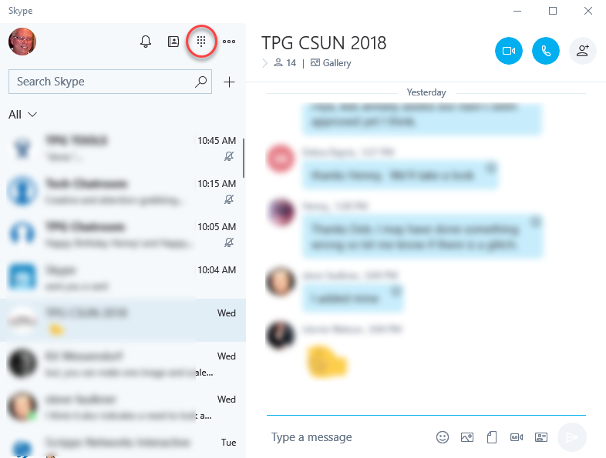
Notes:
What is the purpose of this icon that looks like a 3 by 3 pattern of dots with a 4th row that has one dot in the middle?

Slide 20
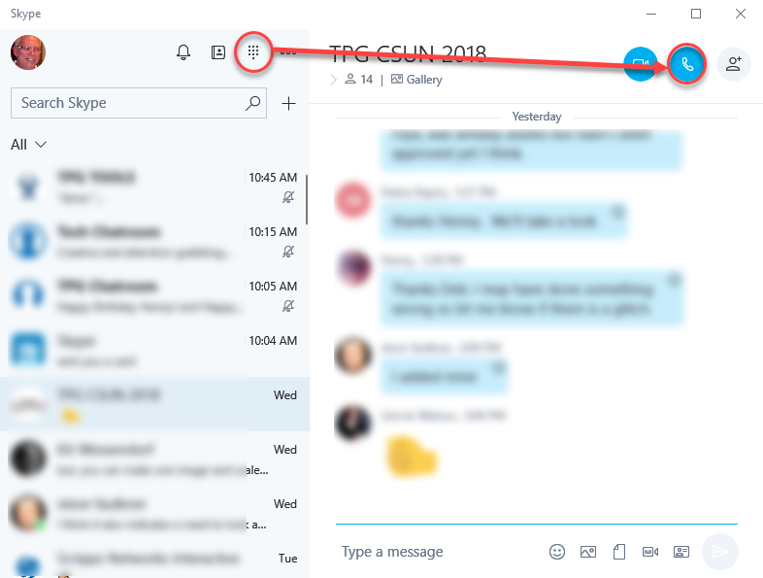
Notes:
Hard to believe it has essentially the same purpose as this icon of a telephone handset

Slide 21
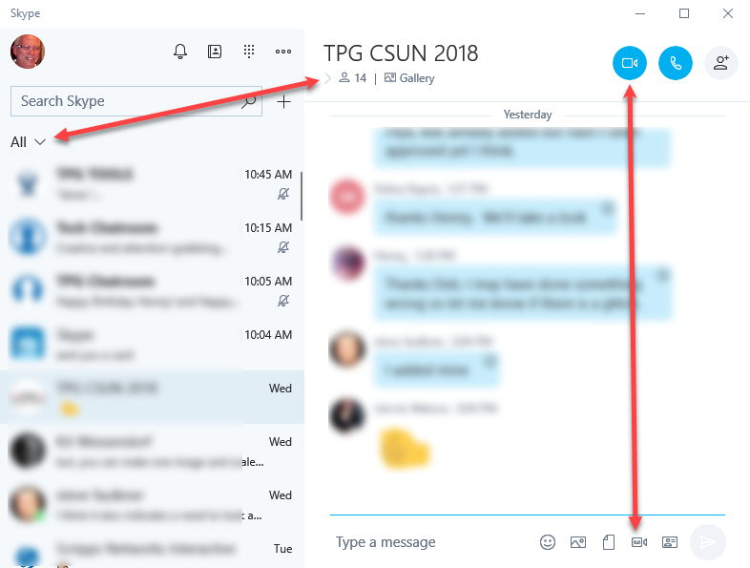
Notes:
There are icons that look slightly different, but do the same thing – right and down pointing chevrons both open something
There are icons that look slightly different, but do different things – camera icons for a video call or attaching a video message

Slide 22
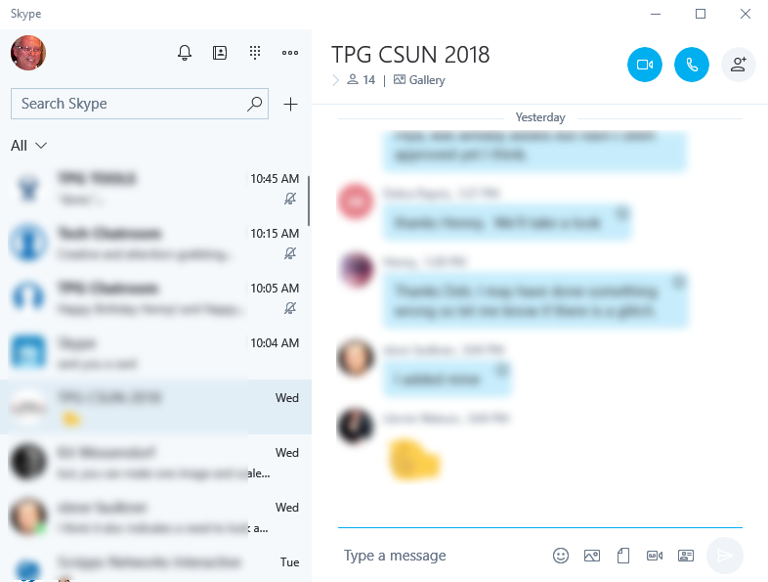
Notes:
It isn’t just about icons or symbols.
There are two places to type on this UI.
One has a familiar rectangle outline, the other is just the words “Type a message” in a space that does not look big enough for typing a message
In a way “Type a message” looks like a label for the icons. Nothing about them provide a familiar visual cue for a place to type.

Slide 23
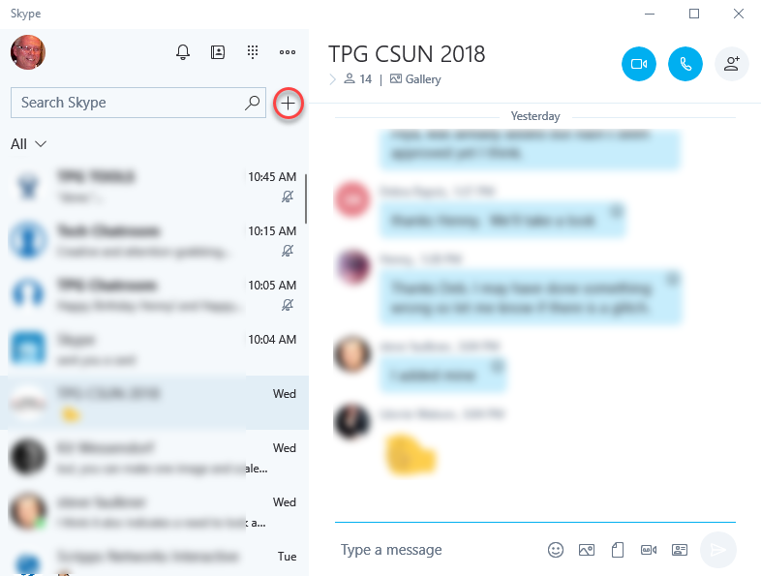
Notes:
Last example where context does not always help.
A plus symbol is randomly hanging out at the end of the search field.
Not hard to understand that it means add, and even if I don’t, mouseover shows New which is a bit like add.
What isn’t clear is new what?

Slide 24
Confusing words, confusing pictures…
How does anyone communicate anything to anyone?

Slide 25
Icons & the conundrum
Enhance visual experience
Save space
Universal language
Known worldwide
Intuitive, easy to remember
Symbolic visual cues, communicating with pictures
Vague
Ambiguous
Confusing
Misunderstood
Thought that meant close, not delete!
Impossible to learn or remember
Notes:
Icons can be
visually pleasing, helpful, efficient, easy for some to remember & act as reminders to do something
And can be a
Showstopper or worse, hard to figure out & remember

Slide 26
Conditions & Impacts
Notes:
The condition of our cognitive capability at any moment is influenced by many factors, which cause a wide variety of impacts on our performance.

Slide 27
The Conundrum Part 2
Notes:
Many causes of cognitive impairments and they impact us in a variety of ways. The impacts from a cause can also vary…

Slide 28
Conditions affecting cognitive ability
Dyslexia
Sleep Disorder
Alzheimer's
Huntington's Disease
TBI
Migraine Headaches
Creutzfeldt-Jakob Disease
Language
Dyscalculia
Anxiety
Amnesia
Concussion
episodic memory impairment
Sleepless Night
Autism
Depression
Delirium
Dementia
ADHD
Mood
Down Syndrome
Notes:
Partial list
TBI – can be caused by any type of physical impact, including the impact from sound waves!

Slide 29
Manifestations
Memory (short & long term)
Perception
Reading speed
Comprehension (time & level)
Attention span
Moments of confusion
Reason
Prioritize
Speak
Recognition & association
Judgement
Coordination
Notes:
Many possible impacts from a condition associated with our cognitive ability

Slide 30
Cognitive ability: Meet Anne
Morning – Afternoon - Evening
Yesterday – Today - Tomorrow
Cornucopia of solutions
Cognitive capacity
Cognitive load
Cognitive reserve
Notes:
Cognitive capacity – similar to physical energy, only so much available in a day
Load – limit to amount of stimulus processed at a time (i.e. brain filters out background information)
Reserve – defense mechanism, performance below average

Slide 31
Meet You or Me…
At 16, 21, 40, 70
Sleep deprived or just tired, at the end of the day, and must order a gift online today
After an exceptionally annoying 90 minute rush-hour crawl home
Rushing online to make a payment minutes before it is due
Notes:
Age changes our cognitive ability

Slide 32
Constantly changing
Human cognitive capability varies
Over time
Within a day & day-to-day
From person to person
Due to an accident, sports injury, or simply falling down
As the result of a disease, medical condition, or prescribed medication

Slide 33
People
Read and comprehend
At a rapid rate
At a measured rate, sometimes slowly
Recognize & understand a
Small set of common objects
Large set of common objects
Struggle comprehending what to do
With large amounts of information
Without being able to see the big picture
Can complete a long or complex task
Over multiple sessions
In a single session
Are easily
Able to focus on something until it is ‘done’
Distracted while doing something
Understand information better when it is
Provided in symbols (1 + 2 = 3)
Provided in words (one plus two equals three)
Notes:
Some of the many opposite needs people have

Slide 34
Solutions: Options & Information
Notes:
The everchanging, competing and diametrically opposite needs of people
can be accommodated with options and information

Slide 35
Technology now & tomorrow
Limitations
One-size-fits-one Digital Inclusion
Personalization
Opportunities & WCAG 2.1 SC
Notes:
Global Public Inclusive Infrastructure

Slide 36
Proposed WCAG 2.1 Success Criteria
2.4.12: Label in Name (A)
Information: Visible label content must be included in the accessible name content and ideally, it perfectly matches or begins with the label content
2.5.1: Pointer Gestures (A)
Option: If it works with pointer gestures, it must also work with single-point activation
2.5.2: Pointer Cancellation (A)
Option: Single point has no down-events; abort or undo; up reversal, or; it’s essential
2.6.1: Motion Actuation (A)
Option: If it works with user or device motion, then it must also work with UI components AND it must be possible to turn off the motion functionality
Notes:
Not going into details of new SC
Simply pointing out that several of them with benefits for cognitive abilities provide user options or more information

Slide 37
Proposed WCAG 2.1 Success Criteria
1.3.4: Identify Common Purpose (AA)
Information: Inputs mapping to HTML 5.2 Autofill field names are programmatically determinable
1.4.10: Reflow (AA)
Option: Prohibits two-dimensional scrolling when content is enlarged up to 400% of original size
1.4.12: Text Spacing (AA)
Option: Allows user to adjust line height, spacing after paragraphs, letter and word spacing

Slide 38
Proposed WCAG 2.1 Success Criteria
1.4.13: Content on Hover or Focus (AA)
Option: Provides more user control over displaying & dismissing the content
2.6.2: Orientation (AA)
Option: Content display cannot be restricted to a single orientation if a device can change the content orientation when the device orientation changes

Slide 39
Proposed WCAG 2.1 Success Criteria
1.3.5: Identify Purpose (AAA)
Information: Programmatically determinable UI components, icons, and regions
2.2.6: Timeouts (AAA)
Information: “Where data can be lost due to user inactivity, users are warned about the estimated length of inactivity that generates the data loss, unless the data is preserved for a minimum of 20 hours of user inactivity.”
2.2.7: Animation from Interactions (AAA)
Option: For non-essential animations triggered by a user action, there is a mechanism to disable the animations yet still perform the action.
2.5.4: Concurrent Input Mechanisms (AAA)
Option: Prohibits, with limited exceptions, restricting a platform’s input methods

Slide 40
Can do now
Option: Select list or group of radio buttons / checkboxes
Option: Accordions with both show/hide all or one-by-one functionality
Option: User control to save, hide, or remove content
Accounts on a summary page, stored credit card numbers, shipping & email addresses, favorites
Option: User control over login landing page
Option: Accept multiple valid date formats:
01/31/2018
01-31-2018
01_31_2018

Slide 41
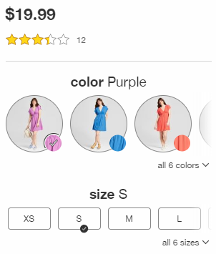
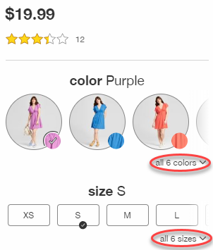
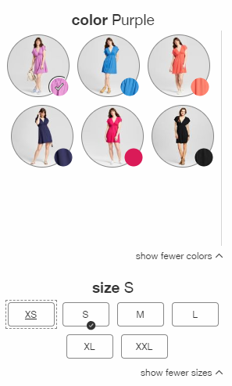
Can do now

Slide 42
Can do now
Option: Change line height, spacing after paragraphs, spacing between letters and words
Option: Slider, adjustable by sliding finger or grabbing handle with mouse pointer is also adjustable by tapping anywhere along the slider path or on buttons at each end
Option: Longer form all on one page or in logical small pieces over multiple pages, in an accordion, on multiple tabs, etc.
Option: Responsive design using breakpoints

Slide 43
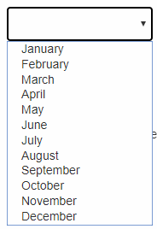
Can do now

Slide 44
Can do now
Information: Put a word with an icon, especially when introducing a new icon. Best always visible, good on a mouseover and onfocus tooltip.
Information: Identify all the information needed to successfully complete a form upfront. For long or complex forms that require gathering information (i.e. a mortgage application), consider offering a printable list.
Information: Provide easy access (i.e. popup or modal) to definitions for jargon or unusual words
Options & Information: Consider what the 2 or 3 of 10 study participants who didn’t understand something have to say, then creatively include options/info to meet their needs, rather than expect them to adapt.

Slide 45
Questions

